Slide 1


Category-Based Social Media Feed
A new Approach to Social Media Feeds

Slide 2
Team Information
Rajvi Gandhi - 92400527119
Mukti Bhanderi - 92400527086

Slide 3
Problem Statement
Reels are usually shown in one continuous feed.
Different types of content can appear one after another.
Users can easily lose a reel they were watching.

Slide 4
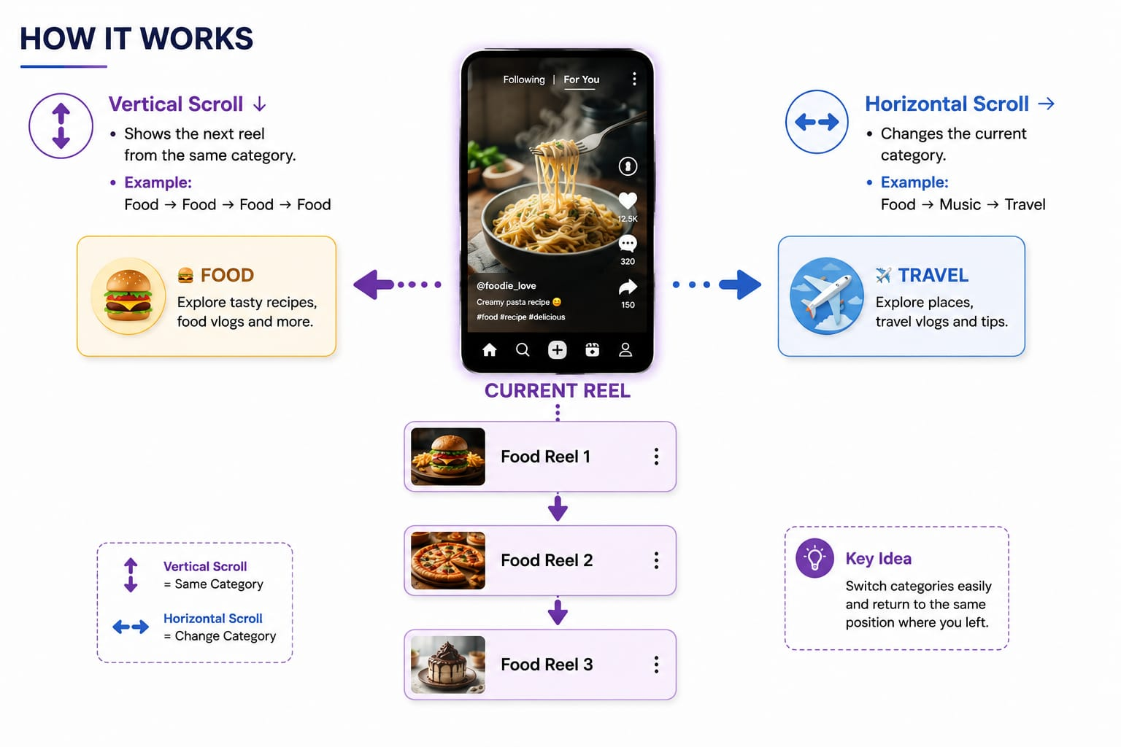
Proposed Solution: Overview
OUR IDEA : A social-media feed with two-direction navigation.

Slide 5
Objectives
Create an easy-to-use social-media website.
Organize reels using categories and hashtags.
Allow vertical scrolling within a category.
Allow horizontal movement between categories.
Remember the user's position in each category.
Provide secure user login.

Slide 6
Server Requirements and Technology Stack
Software: PHP 8.x, MySQL, XAMPP, VS Code, phpMyAdmin, JavaScript, HTML5 & CSS3
Frontend: HTML5, CSS3, JS
Backend: PHP
Database: MySQL
Tools: phpMyAdmin, XAMPP ,VS Code ,Git & GitHub

Slide 7
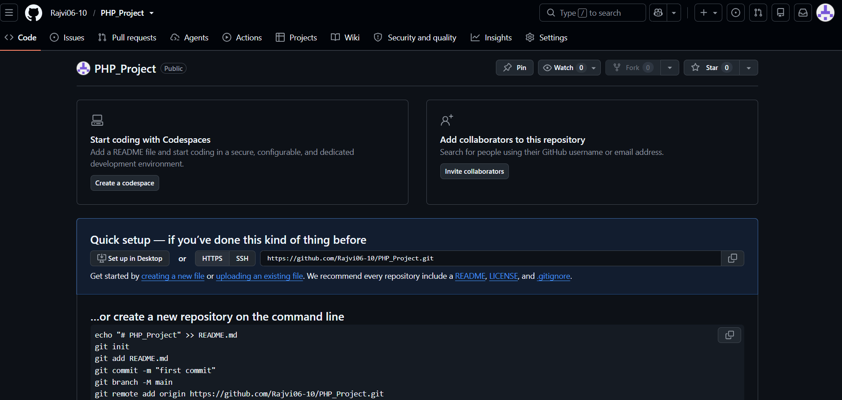
GITHUB : https://github.com/Rajvi06-10/PHP_Project

Slide 8
Database Design
User - User ID, Name, Email, Password
Category - Category ID, Category Name
Reel - Reel ID, User ID, Category ID, Video, Caption, Hashtags
Like - Like ID, User ID, Reel ID
Comment - Comment ID, User ID, Reel ID, Comment
Saved Reel - Save ID, User ID, Reel ID
Follow - Follower ID, Following ID

Slide 9
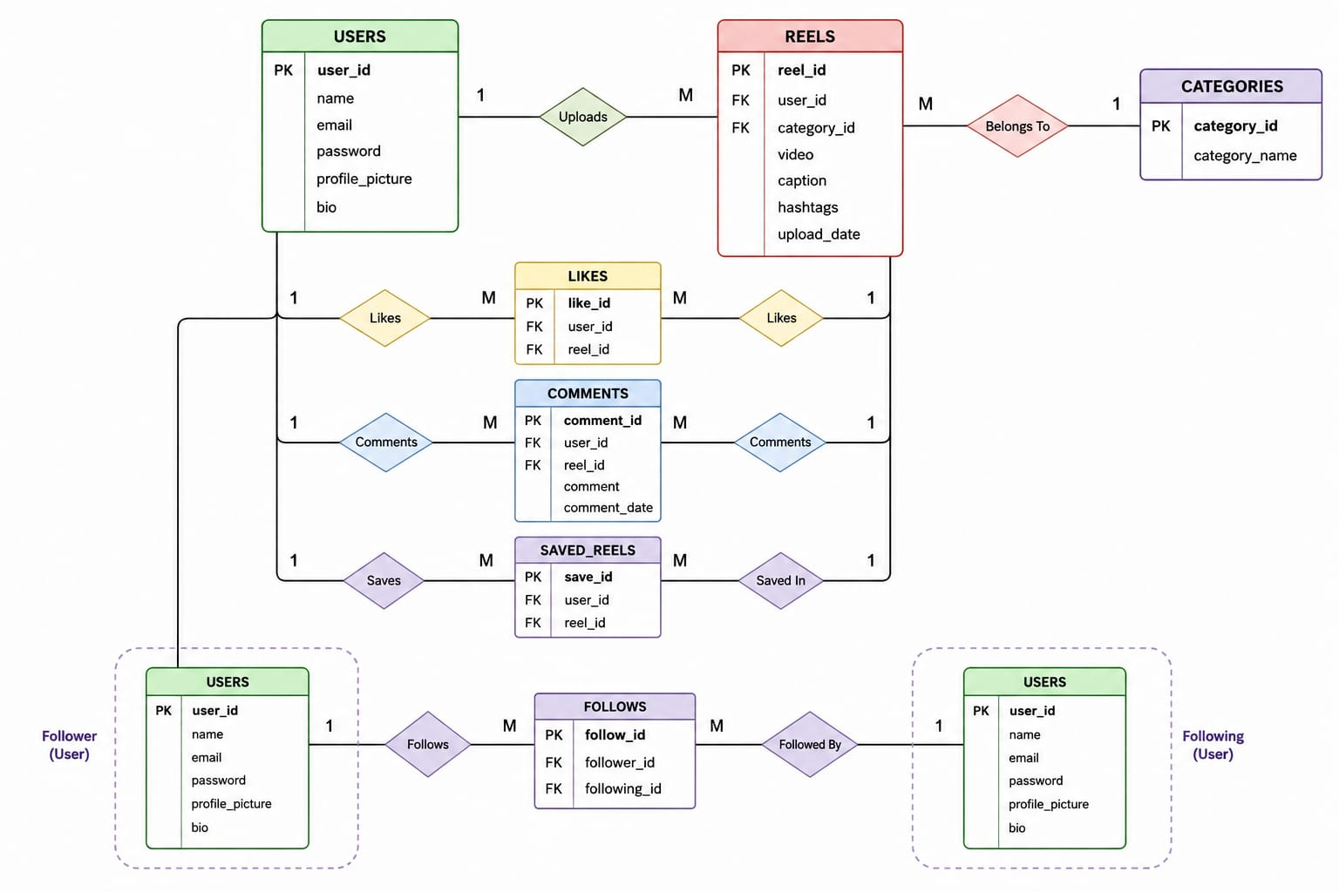
ER Diagram

Slide 10
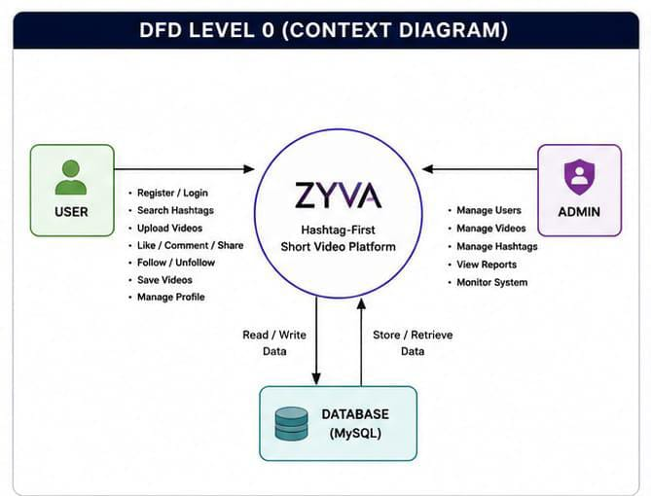
DFD DIAGRAM

Slide 11
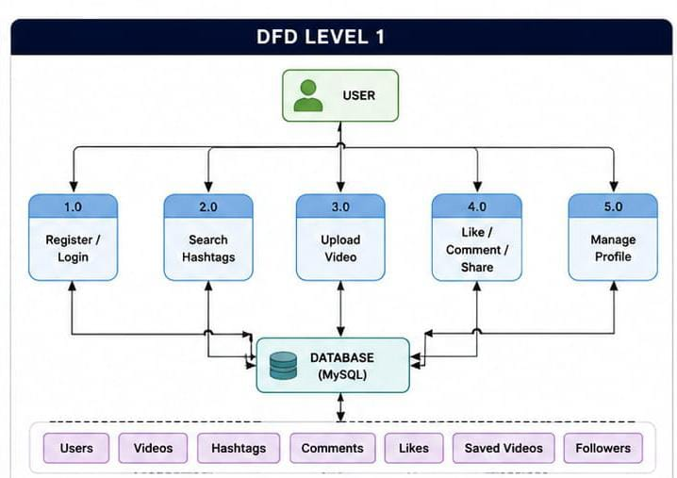
DFD DIAGRAM

Slide 12
Challenges & Learning
Challenges
Designing the category-based feed.
Implementing horizontal and vertical scrolling.
Maintaining reel position.
Designing the database.
Connecting PHP with MySQL.
Handling user sessions.
Learning
PHP Programming
MySQL Database Design
CRUD Operations
Session Management
Frontend Development
PHP & MySQL Integration

Slide 13
References
Instagram (Studied feed structure and reels navigation)
Facebook (Studied social media interaction features)
TikTok (Studied short-video feed and user engagement)
YouTube Shorts (Studied video recommendation and scrolling experience)

Slide 14
THANK YOU

